Slide 1

PySpark Bucketing
Adan Ali

Slide 2

SORTING YOUR LIBRARY
Imagine two huge libraries. You want to find all books they share in common.
The Chaos Method (Shuffle): You throw all books into a giant pile in the middle of a field, sort them, then compare. It’s slow and messy.
The Bucket Method: You agree that both libraries will sort books into 100 specific bins based on the author's name. Now, you only ever compare Bin #1 with Bin #1.

Slide 3
WHAT IS BUCKETING?
Fixed Distribution: Data is organized into a pre-determined number of "buckets" (files) within the table directory. (Normally Parquet Files)
Hash-Based: A hashing function determines which row goes to which file based on a specific column.
Metadata-Aware: Spark saves the bucket information in the Metastore, so it "remembers" where the data lives.
Shuffle Elimination: Since data is already co-located by key, Spark can skip the costly network exchange during joins.

Slide 4

THE HASHING MATH
Spark uses a specific formula to ensure the same value always lands in the same bucket file:
100%
DETERMINISTIC
If you have 100 buckets, the ID will always be between 0 and 99.

Slide 5
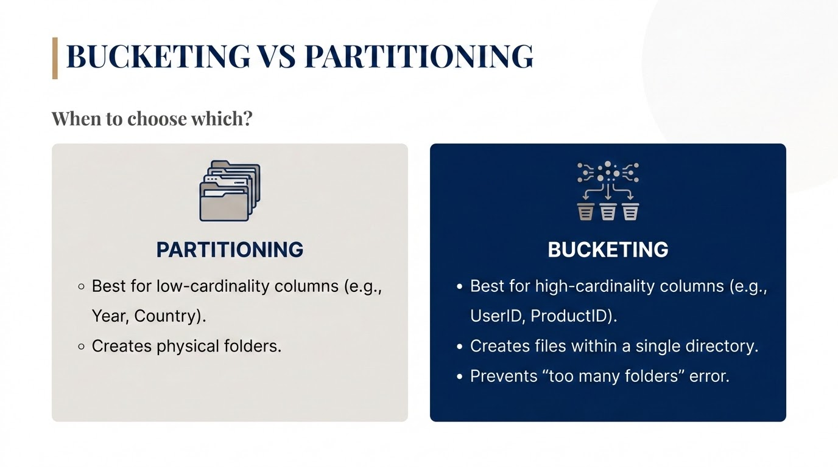

Slide 6
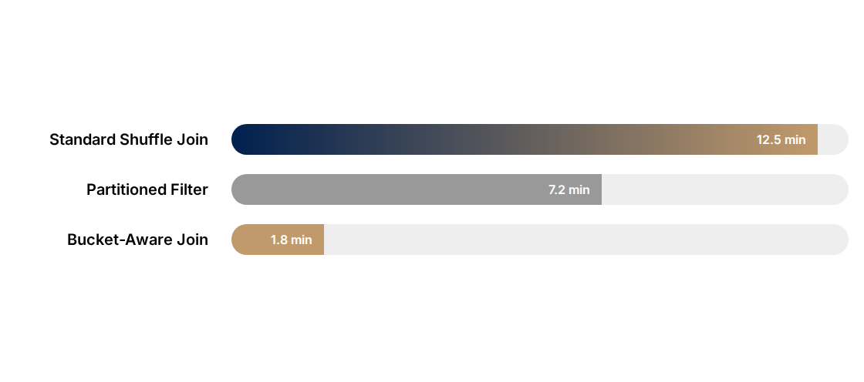
PERFORMANCE IMPACT
Time taken for a 1TB Join operation (Lower is better):
By avoiding the Shuffle stage, we reduce network I/O by up to 90%.

Slide 7
THE GOLDEN RULES
Rule of N: Joined tables must have the same number of buckets (or a multiple) to trigger optimization.
Cardinality: Use bucketing for columns with millions of unique values where partitioning fails.
Sort Consistency: Always sort your buckets (sortBy) to allow for faster Sort-Merge Joins.
Table Only: Bucketing only works if you use saveAsTable(). Writing to raw Parquet files loses the benefit.

Slide 8


THE SMALL FILES TRAP
Watch Your Bucket Count!
If you set N = 10,000 for a small table, Spark will create 10,000 tiny files. This creates "NameNode pressure" and slows down your metadata operations.
Goal: Aim for bucket files that are roughly 128MB to 256MB each.

